Slide 1

Emotion-Sensing Learning Assistant (ESLA)
Empowering Educators, Engaging Students

Slide 2

Project Overview
Project Title: Emotion-Sensing Learning Assistant (ESLA)Submission for: Intel Unnati Industrial Training 2025Team: I²nsane CodersMembers: Isha Sahay (1NT23IS085), Ishta Sharma(1NT23IS086)Institution: Nitte Meenakshi Institute of TechnologyDate: July 11, 2025
This presentation details ESLA, an innovative tool leveraging AI to enhance digital learning environments for Intel Unnati Industrial Training 2025.

Slide 3
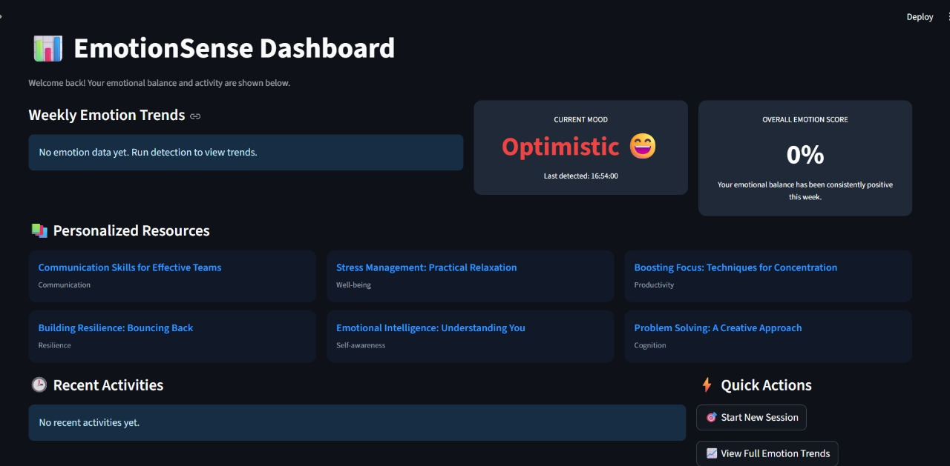
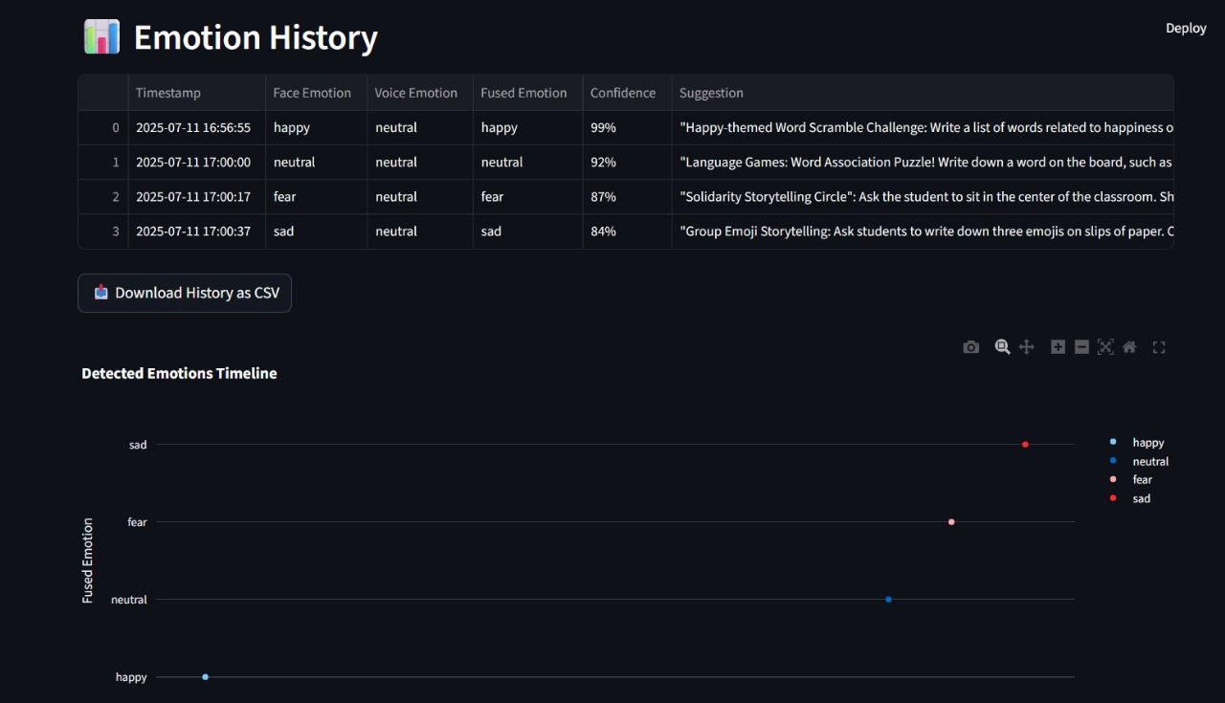
Introduction & Problem Statement
What is ESLA?
ESLA is an Emotion-Sensing Learning Assistant, an AI-powered system designed to provide real-time emotional feedback to educators in online learning environments. It detects and interprets student emotions through facial expressions and voice analysis.
Importance of Emotional Awareness
Understanding student emotions is critical for effective teaching. In digital classrooms, non-verbal cues are often lost, making it challenging for educators to gauge engagement and comprehension.
ESLA bridges this gap, providing insights that foster a more responsive and empathetic online learning experience.

Slide 4



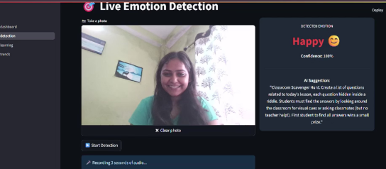
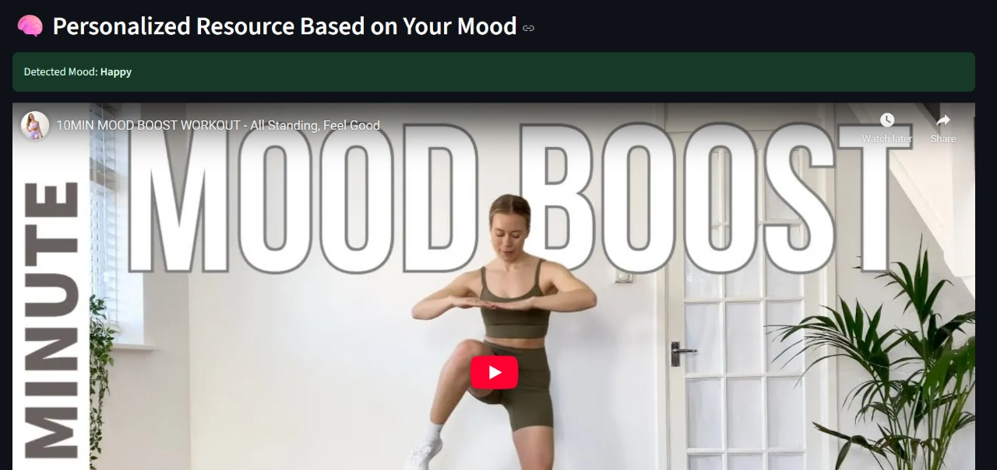



Key Objectives
ESLA aims to revolutionize online education by achieving the following:
Real-time Emotion Detection
Suggest Engaging Content
Detect emotions from student facial expressions and voice tones instantaneously.
Provide educators with tailored suggestions for activities and content to re-engage students.
Visualize Emotion Trends
Improve Teaching Feedback
Display comprehensive emotion logs and trends over time for a holistic view of classroom sentiment.
Empower educators with data-driven insights to refine their teaching methodologies.

Slide 5




Technology Stack
ESLA leverages a robust combination of cutting-edge technologies to deliver its features:
Python & ML Libraries
Streamlit & APIs
Core programming with TensorFlow, DeepFace, and OpenVINO for AI processing.
Streamlit for interactive frontend, integrated with OpenAI and YouTube APIs for dynamic content.
Backend & Databases
Visualization Tools
Robust backend infrastructure ensuring seamless data flow and storage for emotional logs.
Advanced libraries for generating intuitive charts and graphs of emotion trends.
This stack ensures high performance, scalability, and seamless integration for a comprehensive learning assistant.

Slide 6
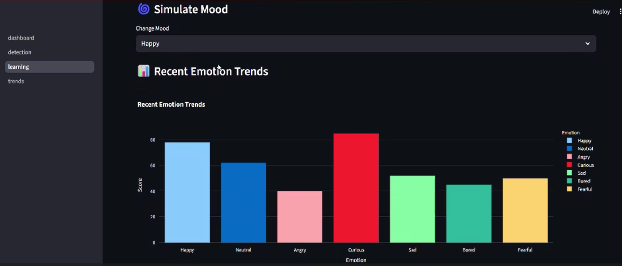
System Overview
ESLA processes real-time audio and video inputs, leveraging AI models to generate insights and practical recommendations for educators.

Slide 7




Key Features
Live Emotion Detection
Real-time analysis of facial expressions and voice nuances to identify student emotions.
AI-Powered Activity Suggestions
Intelligent recommendations for interactive activities based on detected emotional states, powered by OpenAI.
YouTube Video Recommendations
Curated video suggestions to complement lessons and maintain student engagement, integrated via YouTube API.
Comprehensive Dashboard
A centralized hub displaying real-time emotion logs, historical trends, and summary analytics for educators.
These features combine to create a dynamic and responsive learning environment.

Slide 8
Models & Datasets
ESLA utilizes advanced machine learning models trained on specialized datasets:
Facial Emotion Recognition
Voice Emotion Recognition
Model: DeepFace, optimized with TensorFlow
Model: Custom CNN with MFCC (Mel-frequency cepstral coefficients) features
Dataset: FER-2013 (Facial Expression Recognition dataset)
Accuracy: Achieved 91% accuracy in recognizing seven universal emotions (anger, disgust, fear, happiness, sadness, surprise, neutral).
Dataset: RAVDESS (Ryerson Audio-Visual Database of Emotional Speech and Song)
Accuracy: Achieved 88% accuracy in identifying emotions from speech.
Sensor Fusion for Enhanced Reliability
ESLA employs a weighted fusion algorithm combining insights from both facial and voice models. This approach significantly enhances the overall reliability and robustness of emotion detection, providing more accurate and nuanced understanding of student states.

Slide 9
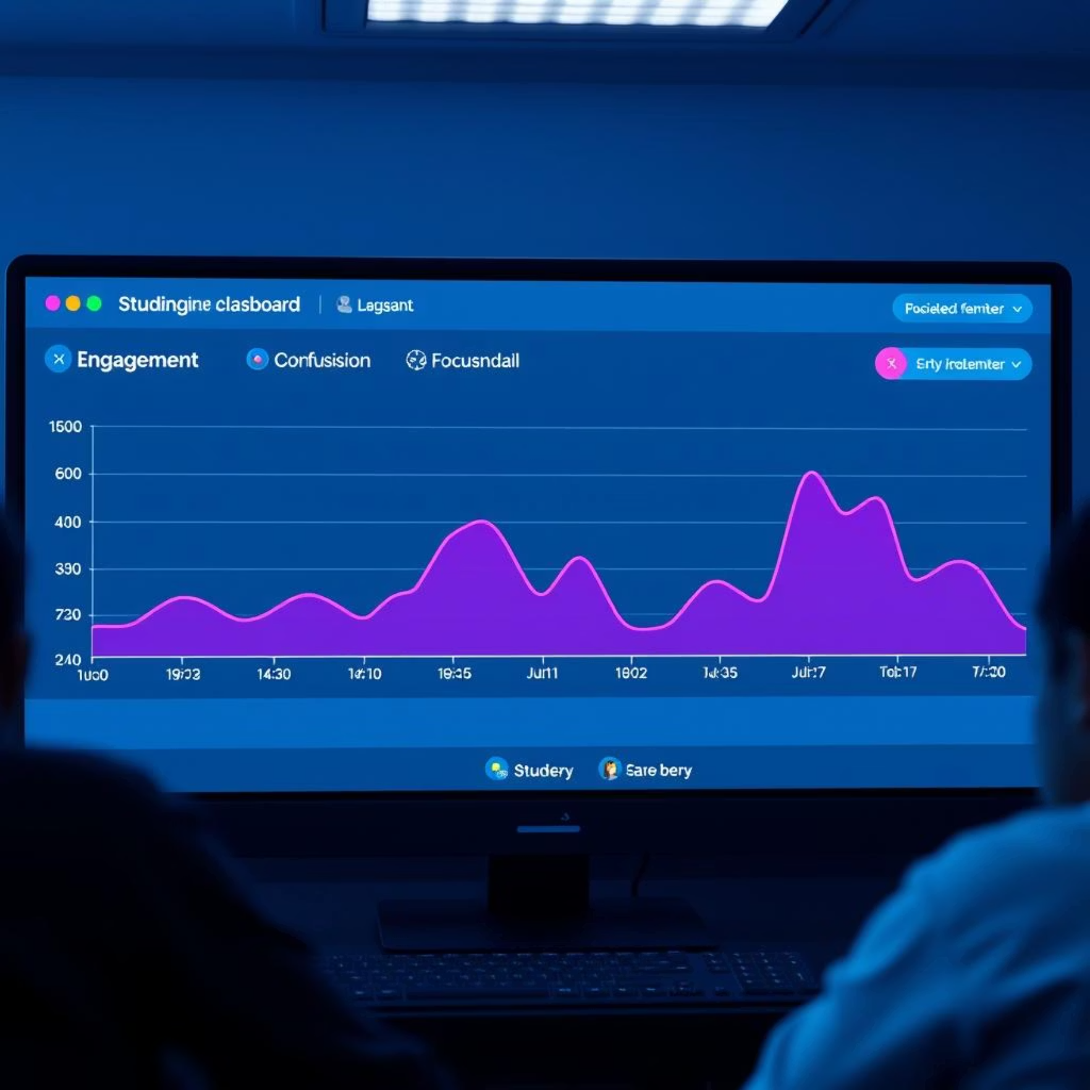
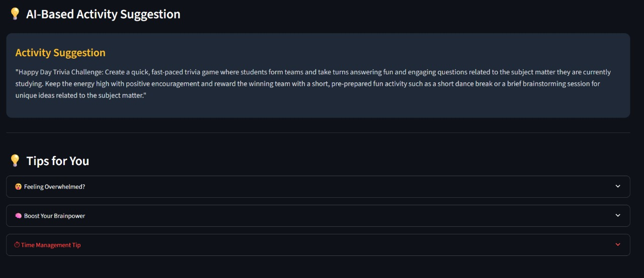
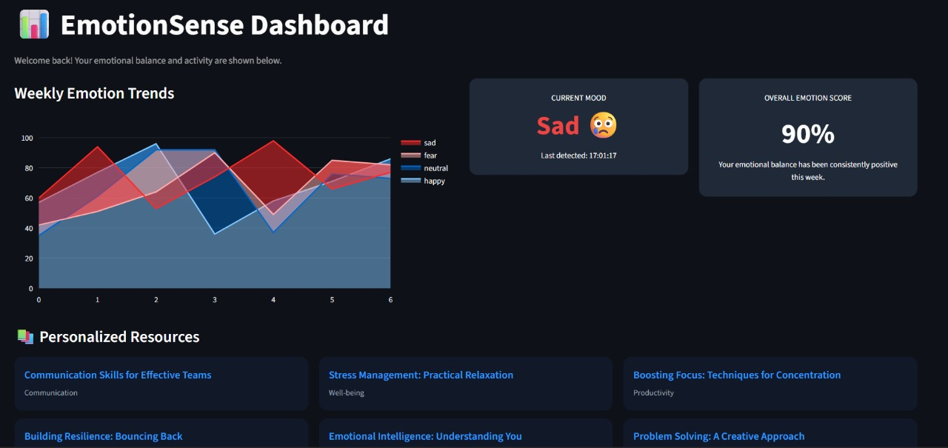
Dashboard & Recommendations
Emotion Distribution 😀 😄 😍
Activity Suggestion Panel
Emotion Logs & Trends
The intuitive dashboard provides educators with actionable insights and intelligent recommendations to adapt their teaching in real-time.

Slide 10
Outcomes & Future Scope
ESLA has demonstrated significant potential in enhancing digital learning:
Overall Accuracy: 56%
Enhanced Student Engagement
Combined facial and voice emotion detection achieves high reliability.
Real-time feedback empowers educators to adapt and maintain student focus.
Future Enhancements
LMS Integration: Seamless integration with popular Learning Management Systems like Moodle or Canvas.
Multilingual Support: Expanding voice emotion detection to support multiple languages.
Docker Deployment: Simplifying deployment and scalability through containerization.
Thank You!
GitHub: https://github.com/Saisha16/Emotion-Sensing-Learning-Assistant
https://github.com/Ishta13/Emotion-Sensing-Learning-Assistant

